Slide 1
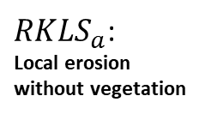
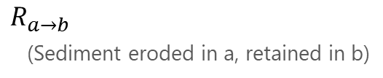
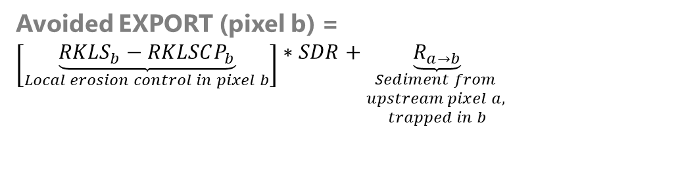
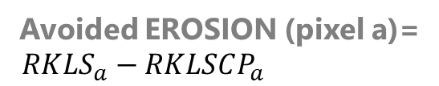
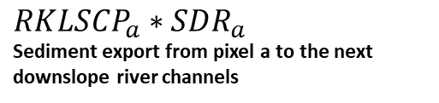

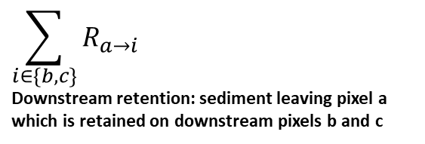

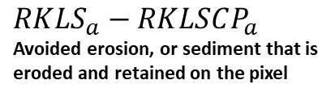
$$RKLS_{a}$$
(maximal local erosion)
$$R_{a→b}$$
(Sediment eroded in a, retained in b)
Pixel a
$$R_{b→c}$$
Avoided EROSION (pixel a)=
$$RKLS_{a}−RKLSCP_{a}$$
Pixel b
Avoided EXPORT (pixel b) =
$$\left[\underset{Local erosion control in pixel b}{\underbrace{RKLS_{b}−RKLSCP_{b}}}\right]∗SDR+\underset{\begin{aligned}Sediment from \\ upstream pixel a, \\ trapped in b\end{aligned}}{\underbrace{R_{a→b}}}$$
Pixel c
Pixel-level sediment budget
Stream pixel
$$RKLSCP_{a}∗SDR_{a}$$
Sediment export from pixel a to the next downslope river channels
$RKLS_{a}$:
Local erosion
without vegetation
$$\sum_{i∈\{b,c\}}{R_{a→i}}$$
Downstream retention: sediment leaving pixel a which is retained on downstream pixels b and c
$$RKLS_{a}−RKLSCP_{a}$$
Avoided erosion, or sediment that is
eroded and retained on the pixel
Notes:
*** This slide was exported and used in the InVEST User Guide, starting with version 3.12.0

Slide 3
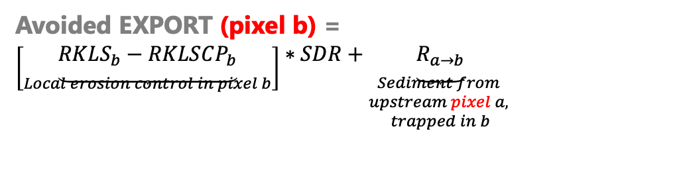
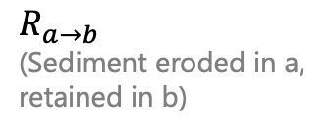
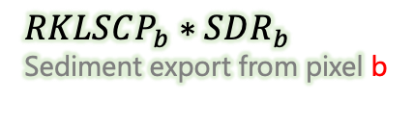
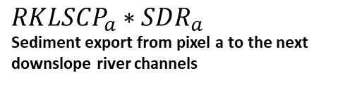
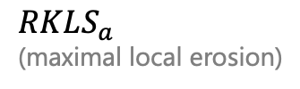
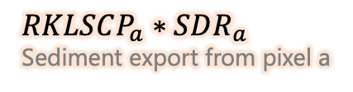
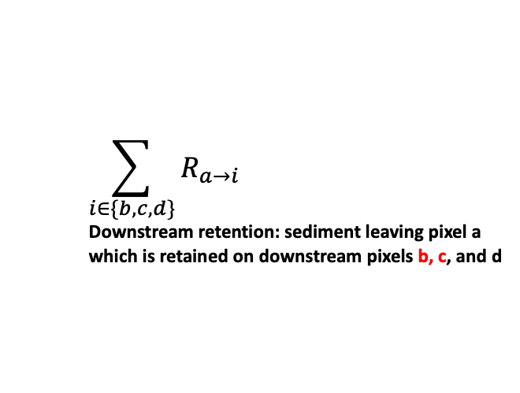
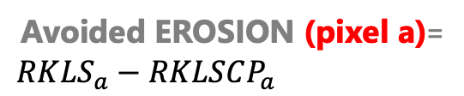
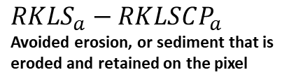

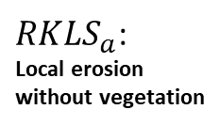
$$R_{a→b}$$
(Sediment eroded in a,
retained in b)
Pixel a
$$RKLS_{a}$$
(maximal local erosion)
Pixel b
$$R_{b→c}$$
Avoided EROSION (pixel a)=
$$RKLS_{a}−RKLSCP_{a}$$
Pixel c
Avoided EXPORT (pixel b) =
$$\left[\underset{Local erosion control in pixel b}{\underbrace{RKLS_{b}−RKLSCP_{b}}}\right]∗SDR+\underset{\begin{aligned}Sediment from \\ upstream pixel a, \\ trapped in b\end{aligned}}{\underbrace{R_{a→b}}}$$
Pixel d
$$RKLSCP_{a}∗SDR_{a}$$
Sediment export from pixel a
$$RKLSCP_{b}∗SDR_{b}$$
Sediment export from pixel b
Pixel-level sediment budget
Stream pixel
$$RKLSCP_{a}∗SDR_{a}$$
Sediment export from pixel a to the next downslope river channels
$RKLS_{a}$:
Local erosion
without vegetation
$$\sum_{i∈\{b,c,d\}}{R_{a→i}}$$
Downstream retention: sediment leaving pixel a which is retained on downstream pixels b, c, and d
$$RKLS_{a}−RKLSCP_{a}$$
Avoided erosion, or sediment that is
eroded and retained on the pixel

Slide 4
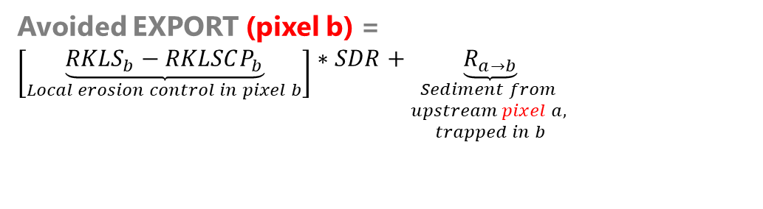





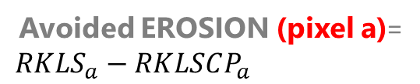
$$R_{a→b}$$
(Sediment eroded in a,
retained in b)
Pixel a
$$RKLS_{a}$$
(maximal local erosion)
Pixel b
$$R_{b→c}$$
Avoided EROSION (pixel a)=
$$RKLS_{a}−RKLSCP_{a}$$
Pixel c
Avoided EXPORT (pixel b) =
$$\left[\underset{Local erosion control in pixel b}{\underbrace{RKLS_{b}−RKLSCP_{b}}}\right]∗SDR+\underset{\begin{aligned}Sediment from \\ upstream pixel a, \\ trapped in b\end{aligned}}{\underbrace{R_{a→b}}}$$
Pixel d
$$RKLSCP_{a}∗SDR_{a}$$
Sediment export from pixel a
$$RKLSCP_{b}∗SDR_{b}$$
Sediment export from pixel b
Pixel-level sediment budget
Stream pixel
$$RKLSCP_{a}∗SDR_{a}$$
Sediment export from pixel a to the next downslope river channels
$RKLS_{a}$:
Local erosion
without vegetation
$$\sum_{i∈\{b,c,d\}}{R_{a→i}}$$
Downstream retention: sediment leaving pixel a which is retained on downstream pixels b, c, and d
$$RKLS_{a}−RKLSCP_{a}$$
Avoided erosion, or sediment that is
eroded and retained on the pixel

Slide 5
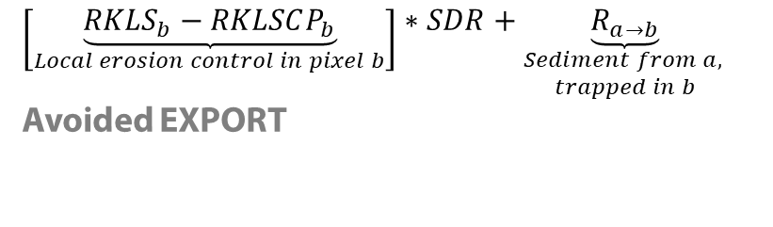

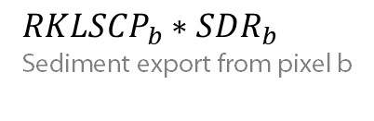
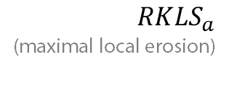

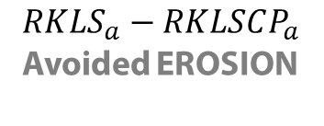

$$R_{a→b}$$
(Sediment eroded in a, retained in b)
Pixel a
$$R_{b→c}$$
Pixel b
$$RKLS_{a}$$
(maximal local erosion)
Pixel c
$$RKLS_{a}−RKLSCP_{a}$$
Avoided EROSION
Pixel d
$$RKLSCP_{a}∗SDR_{a}$$
Sediment export from pixel a
2 new indicators
$$\left[\underset{Local erosion control in pixel b}{\underbrace{RKLS_{b}−RKLSCP_{b}}}\right]∗SDR+\underset{\begin{aligned}Sediment from a, \\ trapped in b\end{aligned}}{\underbrace{R_{a→b}}}$$
Avoided EXPORT
$$RKLSCP_{b}∗SDR_{b}$$
Sediment export from pixel b

Slide 6



$$R_{a→b}$$
(Sediment eroded in a, retained in b)
Pixel a
$$R_{b→c}$$
$$RKLS_{a}$$
(maximal local erosion)
Pixel b
Pixel c
$$RKLS_{a}−RKLSCP_{a}$$
Avoided EROSION
$$RKLSCP_{a}∗SDR_{a}$$
Sediment export from pixel a
2 new indicators
$$\left[\underset{Local erosion control in pixel b}{\underbrace{RKLS_{b}−RKLSCP_{b}}}\right]∗SDR+\underset{\begin{aligned}Sediment from a, \\ trapped in b\end{aligned}}{\underbrace{R_{a→b}}}$$
Avoided EXPORT
$$RKLSCP_{b}∗SDR_{b}$$
Sediment export from pixel b

Slide 7


$$R_{a→b}$$
(Sediment eroded in a, retained in b)
Pixel a
$$R_{b→c}$$
Pixel b
Pixel c

